Slide 1



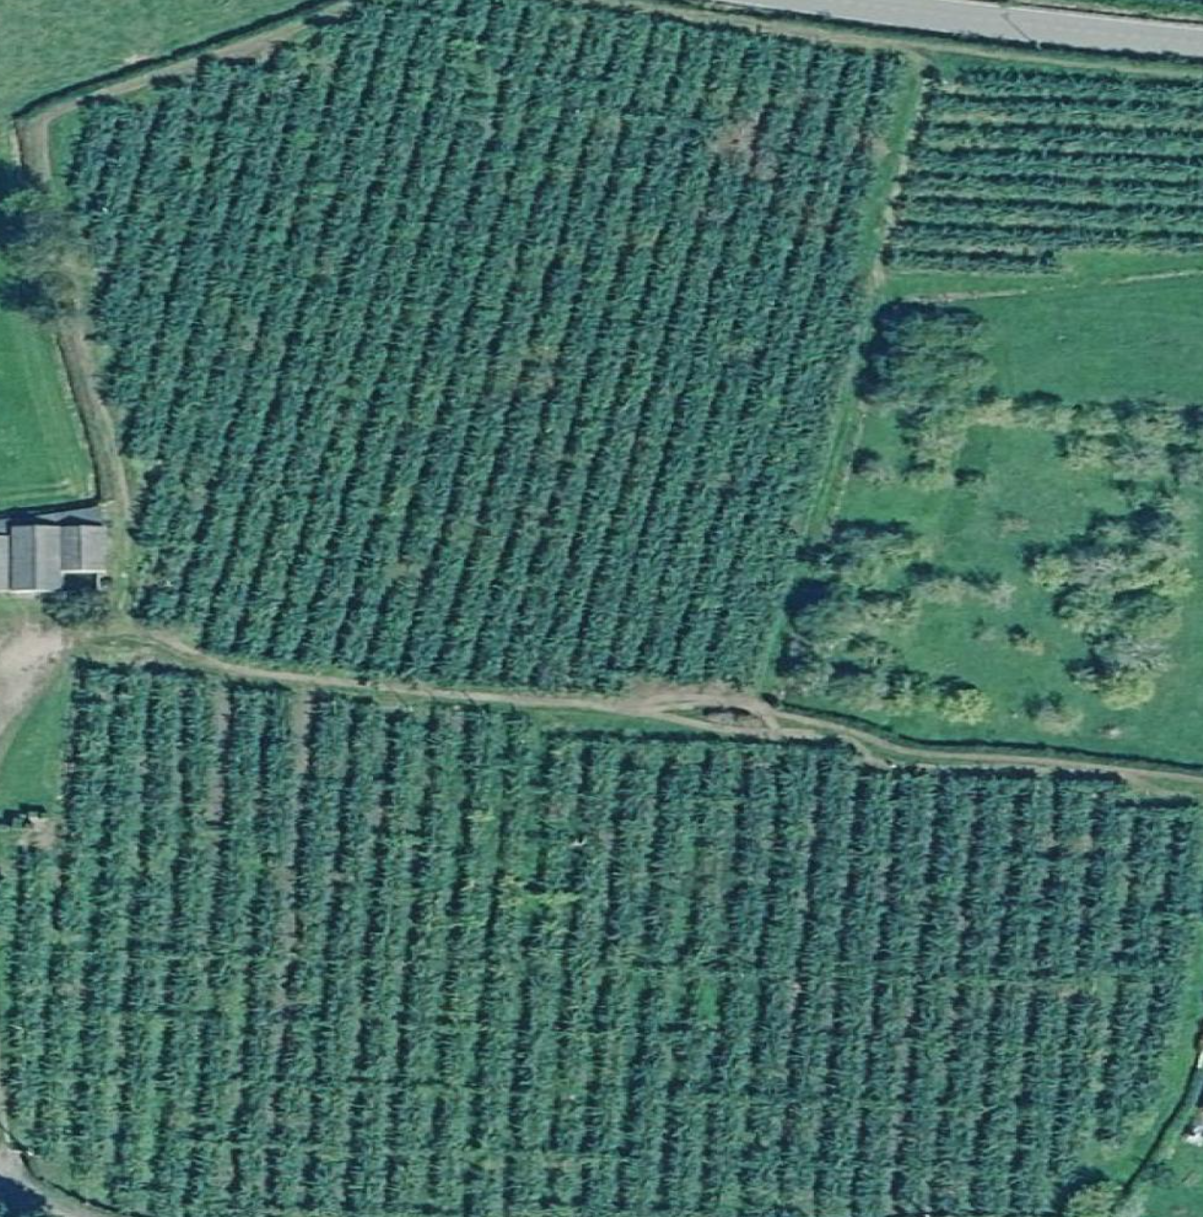

A Shapley-value framework for quantifying module contributions in context-augmented decision support: application to parcel-level land management
Modular architecture
Dataset construction
Panel of judges
Satellite
Vegetation indices
Orthophoto
High-res imagery
RAG
Knowledge base
Parcel selection
Land Use-related
query elaboration
(3) Response generation
Hybrid Human-in-the-Loop
Metrics
143 samples
Correctness
Completeness
Relevance
Utility
Grounding
Methodology stages
1-5 Likert
scale
Broad
Ablation
Analysis & key findings
Correctness
Completeness
Relevance
Utility
Grounding
Validated architecture
Visual context crucial
Marginal contributions successfully quantified
Reproducibility
Dataset is available
Collaborative game theory framework for marginal contributions
SAT
SHAPLEY Values
ORTHO
RAG
Configuration

